Slide 1
2012 Operating Budget
Electric Division
Water Division
Wastewater Division

Slide 2
Core Utility Operations
Wholesale power purchase
Acceptance and delivery of electricity to Stoughton residents and five surrounding townships in Dane and Rock Counties
Pumping,treatment and delivery of water
Collection, treatment and disposal of wastewater to the Yahara River and nutrients to farm fields

Slide 4
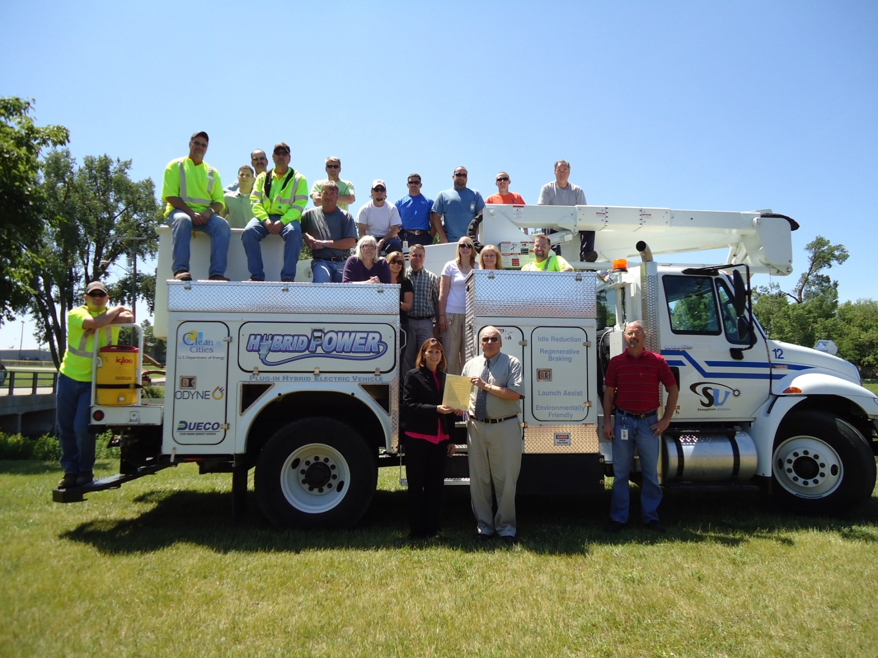

Slide 5
Financial Position
All three divisions are strong
Stable throughout economic downturn
Commercial/Industrial sales trending up
Conservative 0.50% increased sales projection
Adequate and competitive rates – no rate adjustments for 2012
Staff committed to continuous improvement – cost saving measures

Slide 6
Annual Savings to City Budget and Taxpayers
Description | Amount
Payment in lieu of taxes (electric and water) | $ 635,500
Building Rent (net of EMS space) | $ 84,000
Administration fee | $ 55,000
Tax stabilization dividend | $ 46,000
Public fire protection removed from tax bill | $ 420,000
Wisconsin Retirement System UAAL Payoff | $ 24,000
Energy efficiency project savings (235,000 kWh/yr) | $ 32,000
Total (Avoided Property Tax Recovery) | $1,296,500

Slide 7
Continuous Improvements – Annual Savings
Project | Description | Savings
Engineering/system upgrades | Transruptor project | $ 42,000
 | Hwy N reconstruction (projected) | $ 40,000
 | Voltage conversion to 12.4 kV | $ 45,000
 | Wastewater infiltration/inflow reduction | $ 20,000
Energy efficiency | WWTP air blower with VFD | $ 17,000
 | WWTP electric heater replacement | $ 6,700
 | Well Pump – VFD monitoring (SCADA) | $ 18,000
 | Interior/Exterior Lighting/Other | $ 15,000
Personnel | Reduce on call staff by 2 | $ 40,000
 | WRS – UAAL Payoff | $ 11,000
 | WRS – shift to employee responsibility | $ 51,000
 | Vacant position – metering division | $ 72,000

Slide 8
Continuous Improvement – Annual Savings
Project | Description | Savings
Accounting/ Customer Service | Outsource – Monthly bill print and mailing | $ 12,000
 | Electronic (desktop) deposit | $ 8,000
 | In-house year end accrual entries, work order closing, financial statements and regulatory report preparation | $ 10,000
 | Annual Budget Savings | $407,700
 | Equates to Savings/Residential Customer | $38.39
Future Projects | Commercial card expense program
 | Electronic billing, electronic timesheets
 | GIS and work order integration
 | Energy efficiency projects/increased recycling effort

Slide 9
2012 Proposed Cash Outlay - $20,027,340

Slide 10
Operation and Maintenance Expense

Slide 11
Utility Industry Challenges
Cost of improvements to infrastructure
Economic development partnerships
Maintain competitive rates
Retain and attract experienced and certified staff
- Five eligible retirees (20% of employees)
- 17 employees with state licensure (70% of employees)

Slide 12
Wages – IBEW Contract & Other
Position | January 1 and July 1, 2010 | January 1 and July 1, 2011 | January 1, 2012 | January 1, 2013
IBEW (Lineman) | 3.55%, 3.43% | 2.50% | 2.50% | 2.50%
WPPA and Non-Represented | 0.00% | 0.00% | 5.65% Total Proposed Adjustment | TBD

Slide 13
Cumulative % Wage Adjustments

Slide 14
Wages – Remaining (16 positions)
Utilities Committee request for market wage comparison (WI Municipal Utilities)
Stoughton Utilities positions are 3.50% to 15.50% below average market wage
Staff recommended revised budget with market wage adjustments over three years (2012-2014)
Year 1 (2012) adjustment included in 2012 Budget and approved by Utilities Committee, recommended to Council

Slide 15
Wages – Remaining (16 positions)
Overall wage adjustment in 2012 Proposed Budget is $56,000 out of $15.3 million
Total Labor, FICA, WRS – 11.2% of O&M Expense
Wage adjustment plus FICA, WRS contribution is 0.37% of operating expenses in 2012 ($0.50 on the average residential customer bill of $136.00)
Continuous annual improvement savings - $3.20 on average residential monthly customer bill
Wage adjustment can occur within legal guidelines of the state’s Budget Repair Bill and Biennial Budget

Slide 16
2012 Proposed Budget Summary
 |  | Electric | Water | Wastewater | Total
OPERATING REVENUES |  | $ 15,751,784 | $ 1,693,648 | $ 2,095,262 | $ 19,540,694
OPERATING EXPENSES
Operation & Maintenance Expense |  | $ 13,664,824 | $ 727,123 | $ 911,373 | $ 15,303,320
Taxes (PILOT) |  | $ 330,000 | $ 305,500 | $ - | $ 635,500
Depreciation |  | $ 925,500 | $ 368,500 | $ 703,500 | $ 1,997,500
Total Operating Expenses |  | $ 14,920,324 | $ 1,401,123 | $ 1,614,873 | $ 17,936,320
Operating Income |  | $ 831,460 | $ 292,525 | $ 480,389 | $ 1,604,374
Non-operating Revenues (Expenses):
Investment Income |  | $ 140,000 | $ 35,000 | $ 62,000 | $ 237,000
Interest Expenses |  | $ (278,243) | $ (94,742) | $ (108,148) | $ (481,133)
Capital Contributions |  | $ 71,000 | $ - | $ - | $ 71,000
Miscellaneous Revenues (Expenses) |  | $ (35,000) | $ (11,300) | $ - | $ (46,300)
Total Non-operating Revenues (Expenses) |  | $ (102,243) | $ (71,042) | $ (46,148) | $ (219,433)
Net Income |  | $ 729,217 | $ 221,483 | $ 434,241 | $ 1,384,941

Slide 18
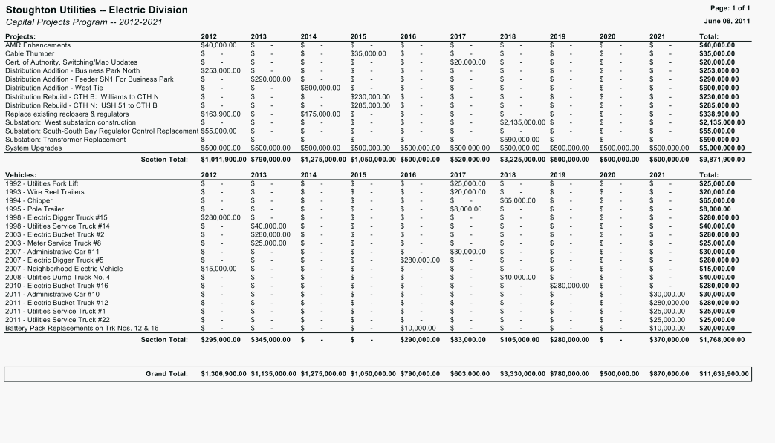

Slide 19
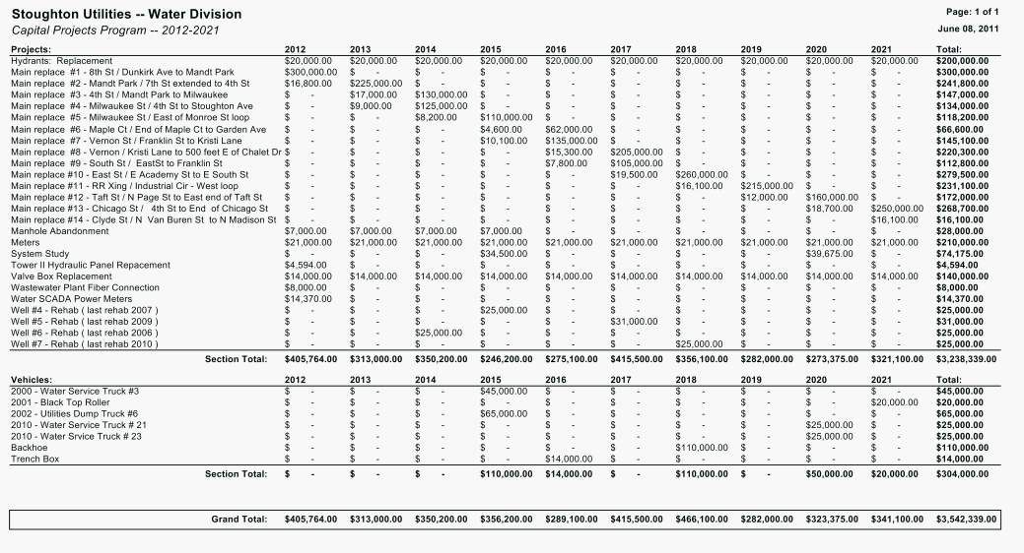

Slide 20
